Slide 1
Why Character Matters!
“Can I ______ and still be a Christian?
NYC 2021

Slide 2
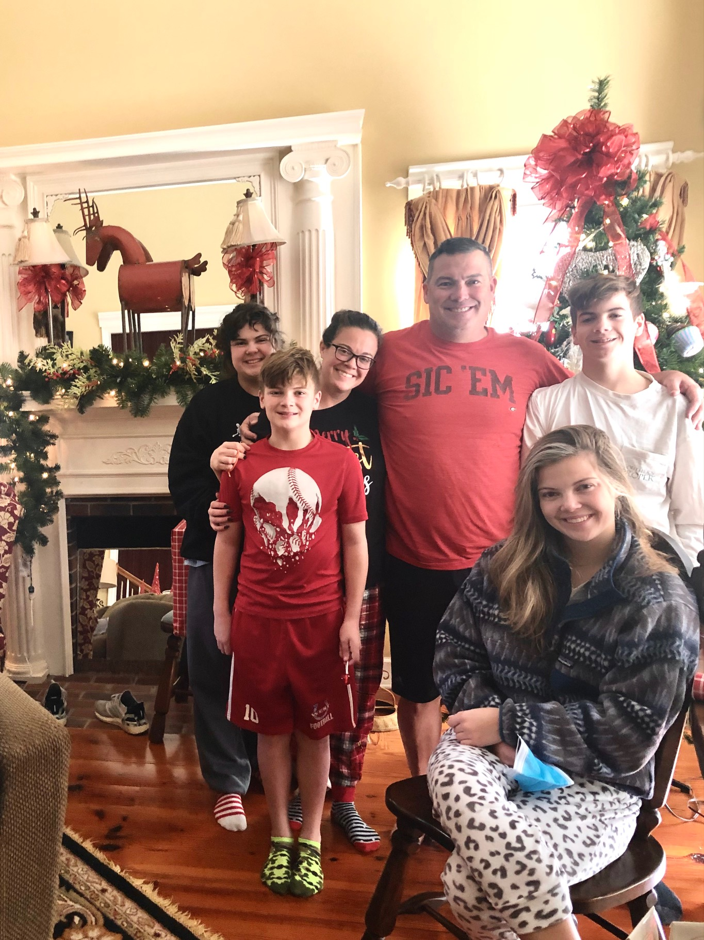

Slide 3
James 2:14-26
14 What good is it, my brothers, if someone says he has faith but does not have works? Can that faith save him? 15 If a brother or sister is poorly clothed and lacking in daily food, 16 and one of you says to them, “Go in peace, be warmed and filled,” without giving them the things needed for the body, what good is that? 17 So also faith by itself, if it does not have works, is dead.

Slide 4
18 But someone will say, “You have faith and I have works.” Show me your faith apart from your works, and I will show you my faith by my works. 19 You believe that God is one; you do well. Even the demons believe—and shudder! 20 Do you want to be shown, you foolish person, that faith apart from works is useless? 21 Was not Abraham our father justified by works when he offered up his son Isaac on the altar? 22 You see that faith was active along with his works, and faith was completed by his works; 23 and the Scripture was fulfilled that says, “Abraham believed God, and it was counted to him as righteousness”—and he was called a friend of God. 24 You see that a person is justified by works and not by faith alone. 25 And in the same way was not also Rahab the prostitute justified by works when she received the messengers and sent them out by another way? 26 For as the body apart from the spirit is dead, so also faith apart from works is dead.

Slide 5
What is saving faith?
Believe the gospel
Believe that Christ is the only way to be saved
Trust

Slide 6
What does saving faith produce?
Relationship -
Conviction -
Love -
Desire to honor the Lord with thought and deed -

Slide 7
“Can I ______ and still be a Christian?”
Is it in the Scriptures?
Am I personally convicted one way or the other?
Does it cause someone else to stumble?
Does it tempt me to sin?

Slide 8
1 John 1:5-7
5 This is the message we have heard from him and proclaim to you, that God is light, and in him is no darkness at all. 6 If we say we have fellowship with him while we walk in darkness, we lie and do not practice the truth. 7 But if we walk in the light, as he is in the light, we have fellowship with one another, and the blood of Jesus his Son cleanses us from all sin.

Slide 9
Proverbs 8:13
“The fear of the Lord is to hate evil;
Pride and arrogance and the evil way
And the perverted mouth, I hate.”
James 4:6
But He gives a greater grace. Therefore it says, “God is opposed to the proud, but gives grace to the humble.” 7 Submit yourselves therefore to God. Resist the devil, and he will flee from you.
1 Peter 5:5
You younger men, likewise, be subject to your elders; and all of you, clothe yourselves with humility toward one another, for God is opposed to the proud, but gives grace to the humble.
Daniel 4:37
Now I, Nebuchadnezzar, praise, exalt and honor the King of heaven, for all His works are true and His ways just, and He is able to humble those who walk in pride.”
Proverbs 15:25
The Lord will tear down the house of the proud,
But He will establish the boundary of the widow.

Slide 10
The Older Brother
25 “Now his older son was in the field, and as he came and drew near to the house, he heard music and dancing. 26 And he called one of the servants and asked what these things meant. 27 And he said to him, ‘Your brother has come, and your father has killed the fattened calf, because he has received him back safe and sound.’ 28 But he was angry and refused to go in. His father came out and entreated him, 29 but he answered his father, ‘Look, these many years I have served you, and I never disobeyed your command, yet you never gave me a young goat, that I might celebrate with my friends. 30 But when this son of yours came, who has devoured your property with prostitutes, you killed the fattened calf for him!’ 31 And he said to him, ‘Son, you are always with me, and all that is mine is yours. 32 It was fitting to celebrate and be glad, for this your brother was dead, and is alive; he was lost, and is found.’”

Slide 11
“Can I ______ and still be a Christian?”
How can I develop my relationship with Christ?
How can I focus on the Lord while at college?
How can I develop my character to honor the Lord with my life?

Slide 12
Does your Character matter to God?
God opposes the proud
God hates sin - He is holy
Sin separates us from Him
Sin enslaves and destroys
Poor character makes us love Him less, you can’t serve 2 masters

Slide 13
Applications
Examine yourself to see if you have a saving faith - 2 Cor 13:5
Develop your relationship - John 15 - abide in Christ
Pursue Righteousness - Col 3 - set your mind on things above
Pursue Humility - Luke 14:10- humble yourselves

